Slide 1

CREATING WEB APPLICATION
DATA PROGRAMMING
GROUP 9
SOORAJ RAJKUMAR POLYRAJ
RITHIN RAVI
SREELEKSHMI SREEJITH BINDU
ANJANA KAPPADAN

Slide 2

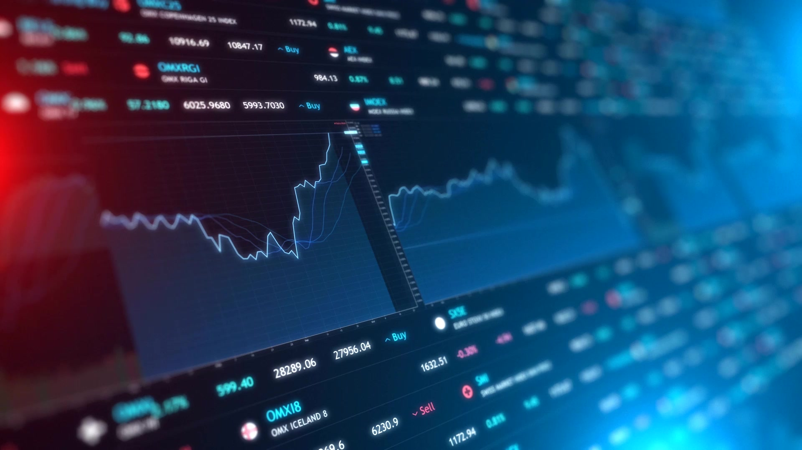
Project Description
We have set up a Flask web application that interacts with a MongoDB database and an external API for retrieving stock market data. The API is called in to retrieve the latest data and this data is stored into MongoDB. The data represents the performance of 50 large and well-established companies listed on the National Stock Exchange (NSE) of India. The API gets fresh data every 24 hours. We have used google charts for producing the visualizations related to this data.

Slide 3



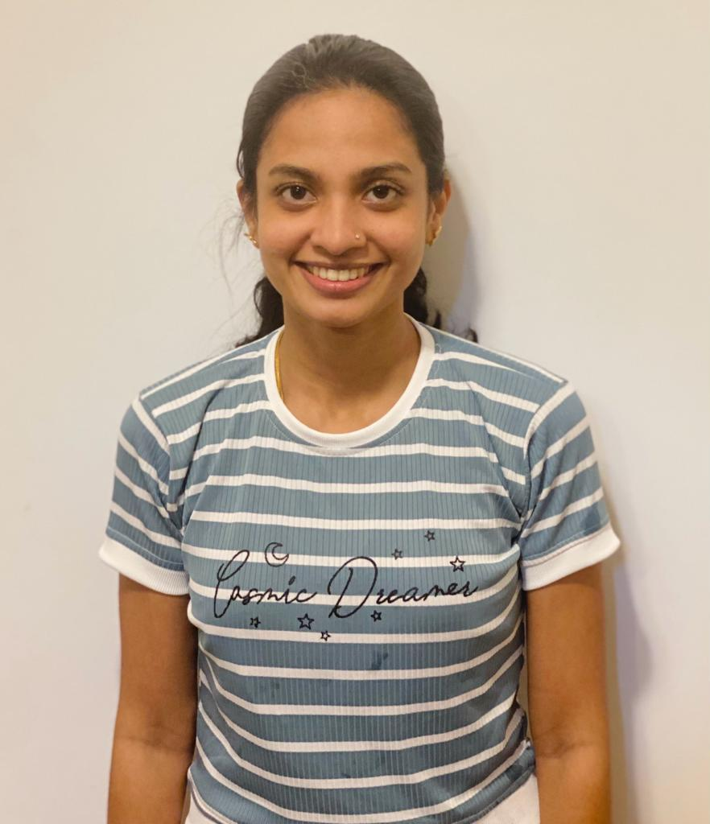
Our Team
SOORAJ RAJKUMAR POLYRAJ
RITHIN RAVI
SREELEKSHMI SREEJITH
BINDU
ANJANA KAPPADAN
Developer
Proficient in HTML, CSS, and JavaScript (Front-end).
Experienced in Python, and Java (Back-end).
Knowledge of MySQL, PostgreSQL, MongoDB.
Data Analyst
Data acquisition proficiency.
Statistical analysis and data modeling expertise.
Familiarity with data visualization tools (e.g., Tableau, Power BI).
Business Analyst
Strong analytical and problem-solving capabilities.
Excellent communication and documentation proficiency.
Understanding of business processes and adept at requirements gathering.
Project Manager
Efficient handling of project tasks and timelines.
Prioritization of activities for optimal productivity.
Versatility in applying Agile or Waterfall methodologies.
Skillful identification and mitigation of project risks.

Slide 4
Tools used
PyCharm:- Python codes were written and run using PyCharm
Flask:- To create a web application
RapidAPI:- To fetch the stock market data
MongoDB:- NoSQL database to store data retrieved from API.
Googlecharts:- To create visualizations.
HTML:- Defines the structure and elements of web pages
CSS:- Defines styles, layouts, and visual presentation of HTML elements.
JavaScript:- Used along with Google charts for creating visualizations.

Slide 5
Indian Stock Market Dashboard: A Python-Powered Analysis with MongoDB Integration and Interactive Visualizations
We have used the Indian stock market API available on the RapidAPI platform: Latest Stock Price API Documentation (suneetk92) | RapidAPI. We had set up a Python program in PyCharm to call this API. The data from the API is loaded into MongoDB. Previous records are always removed to make sure that only the latest data exists in DB. We have used HTML and CSS to create a visually appealing web page. The navigation links on the main page provide users with easy access to various sections of the application, such as stock price changes, day high values, stock volume distribution, and stock data summary. The code for each visualization is placed in separate html files and we have used Google charts along with JavaScript to make the visualizations more meaningful.

Slide 6
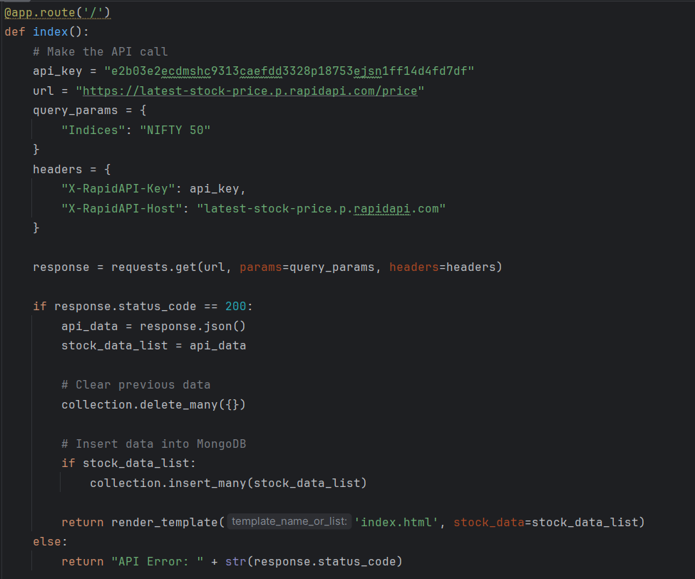
Using the API

Slide 7
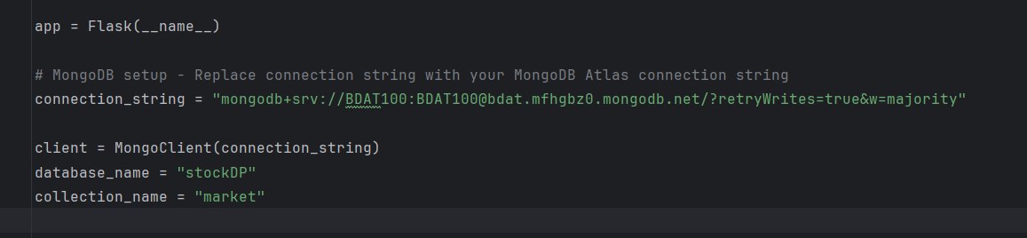
Setting up Cloud Database

Slide 8
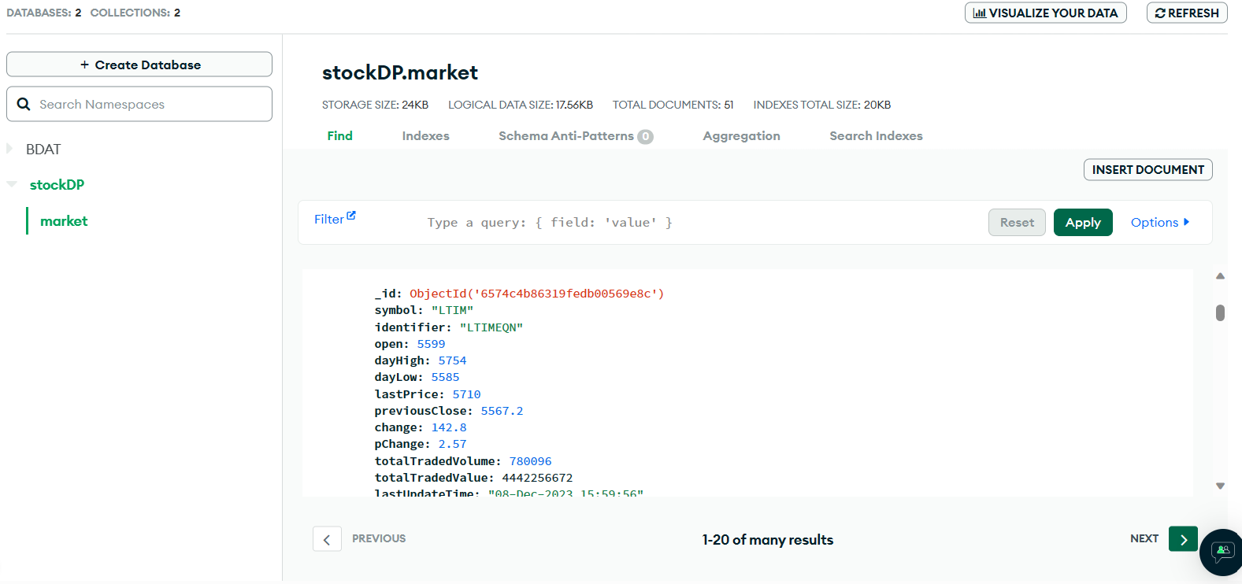
Data has reached MongoDB Server

Slide 9
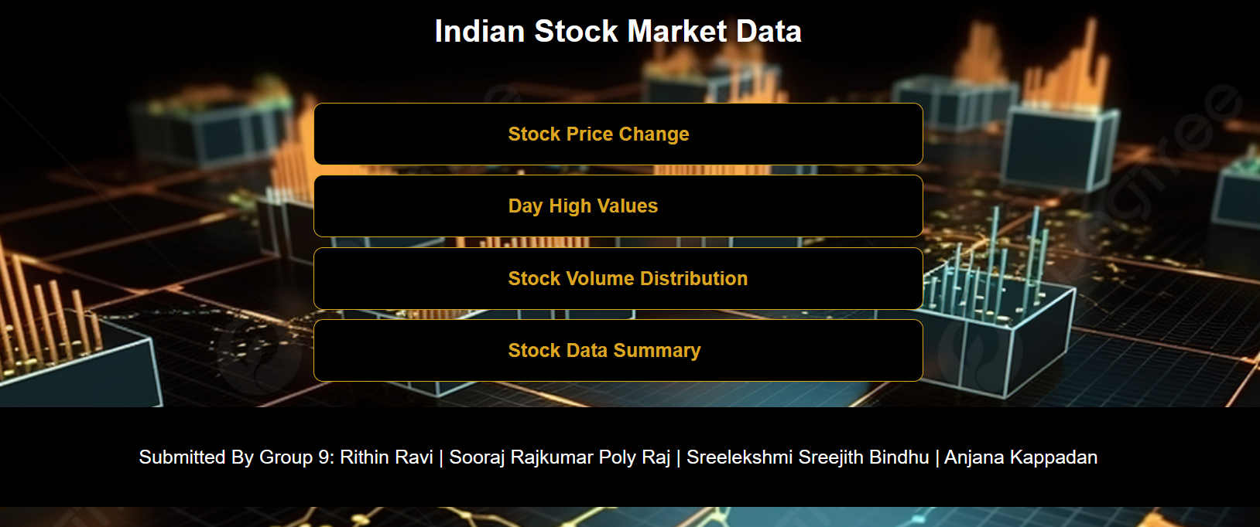
Home Page

Slide 10
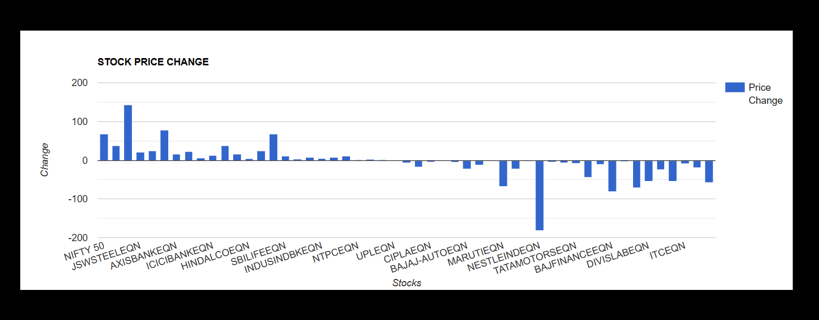
Stock Price change

Slide 11
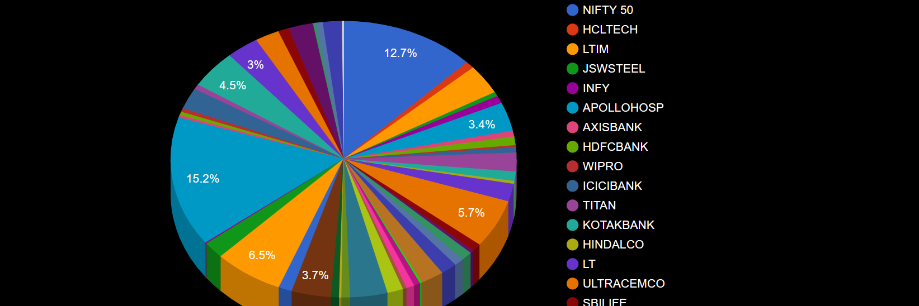
Day high Values

Slide 12
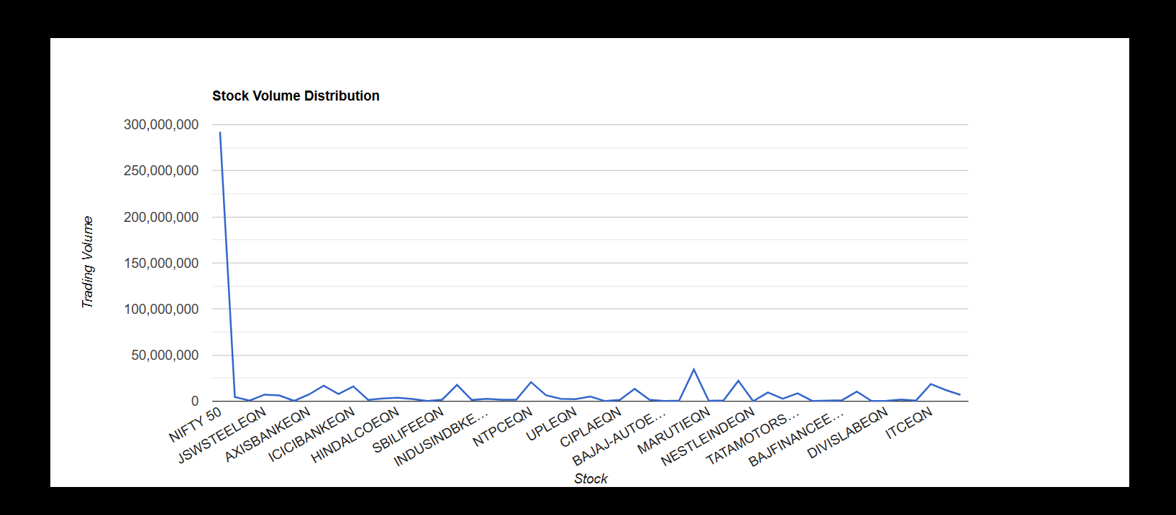
Stock Volume Distribution

Slide 13
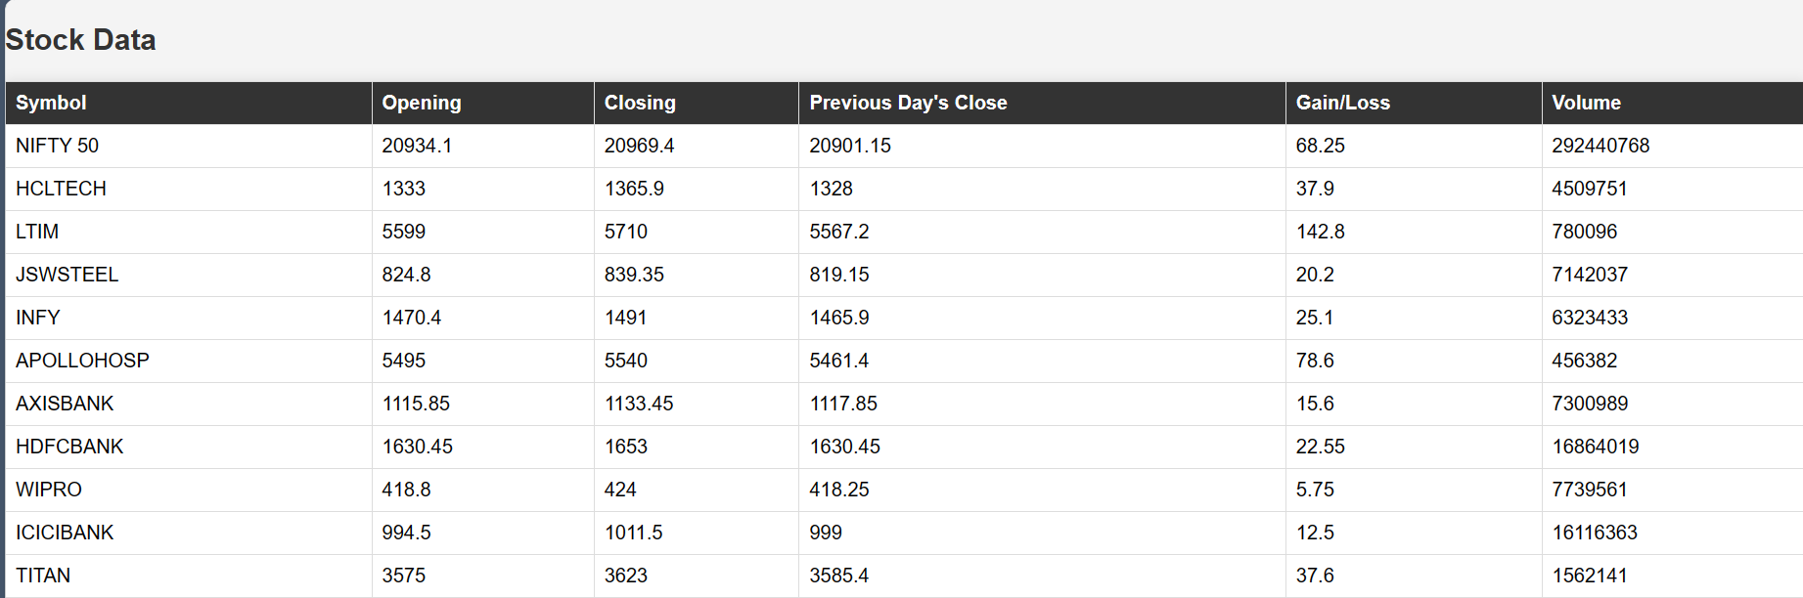
Stock Data Summary

Slide 14
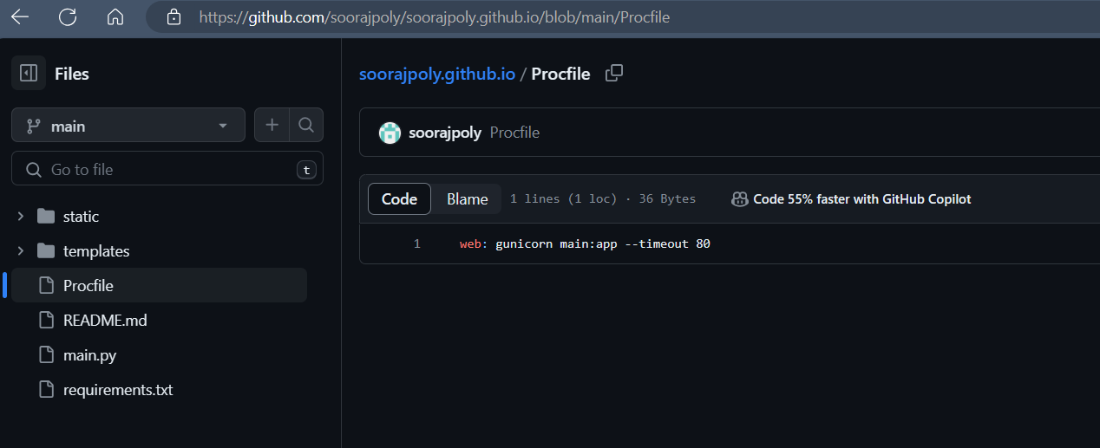
Uploading all the contents to github repository

Slide 15
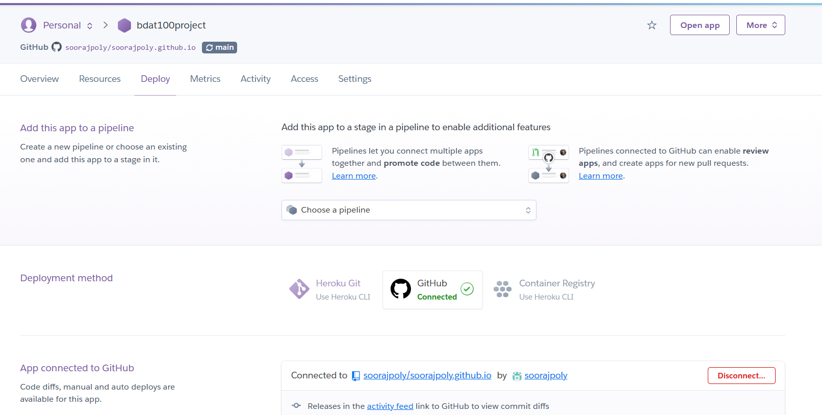
Launching the web application using Heroku An application was launched in Heroku and linked it to github repository containing all the contents of our project.

Slide 16
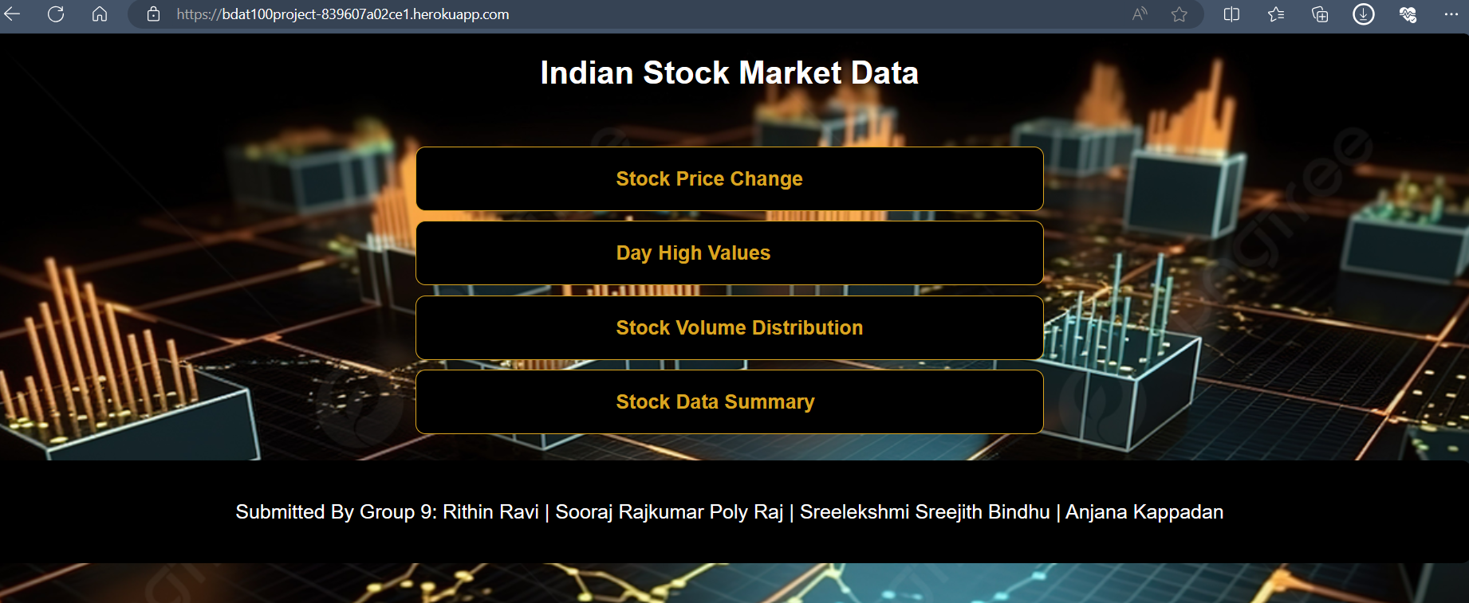
URL to our web application Indian Stock Market Data (bdat100project-839607a02ce1.herokuapp.com)

Slide 17

LIVE DEMO

Slide 18
Thank you

